Slide 1


Domain Name System
Josh Hakala
Network Security W210
UC Berkeley

Slide 2
I was having trouble locating a DNS joke
It's resolved.

Slide 3

Agenda
DNS Overview
Attacks
DNS Spoofing demo
DNSSEC
enumeration demo
DNS over HTTPS
Notes:
DNS protocol - (Zones, Resource Record Types, Caching)
Caching
Attacks
Efforts to Securing (DNSSEC, DNS over HTTPS (DoH), DANE, DNS over TLS, DNScurve, DNScrypt)

Slide 4

DNS Overview
Notes:
Domain Name System: Acts as the Internet Phonebook, primary purpose is to resolve Domain names to IP
Humans have a hard time remembering IP addresses
Application layer:
Software: BIND – Berkeley Internet Name Domain – Most widely used DNS software on the Internet
DNS resolver, Domain Name Authority Server to answer requests from resolvers, and other DNS tools
Typically DNS operates on UDP port 53
Connectionless, Unencrypted, and Unauthenticated traffic

Slide 5
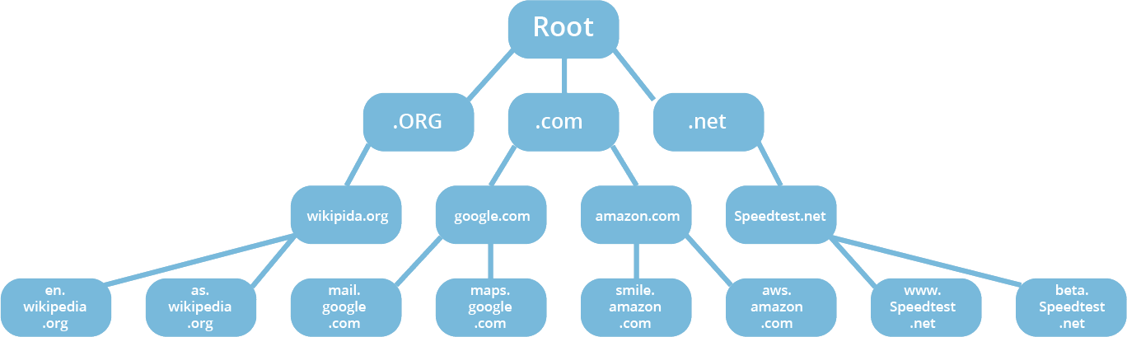
Domain Name System
Notes:
Arranged in Hierarchical zones, 13 root name servers around the world
DNS servers contain zone files

Slide 6
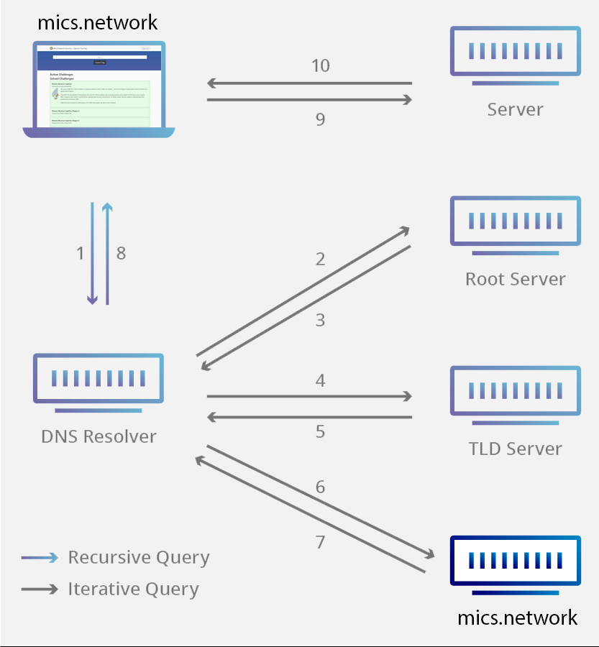
Basic DNS Resolution Process
Notes:
DNS query sent by DNS server on behalf of a host
Record information is stored in zone files

Slide 7
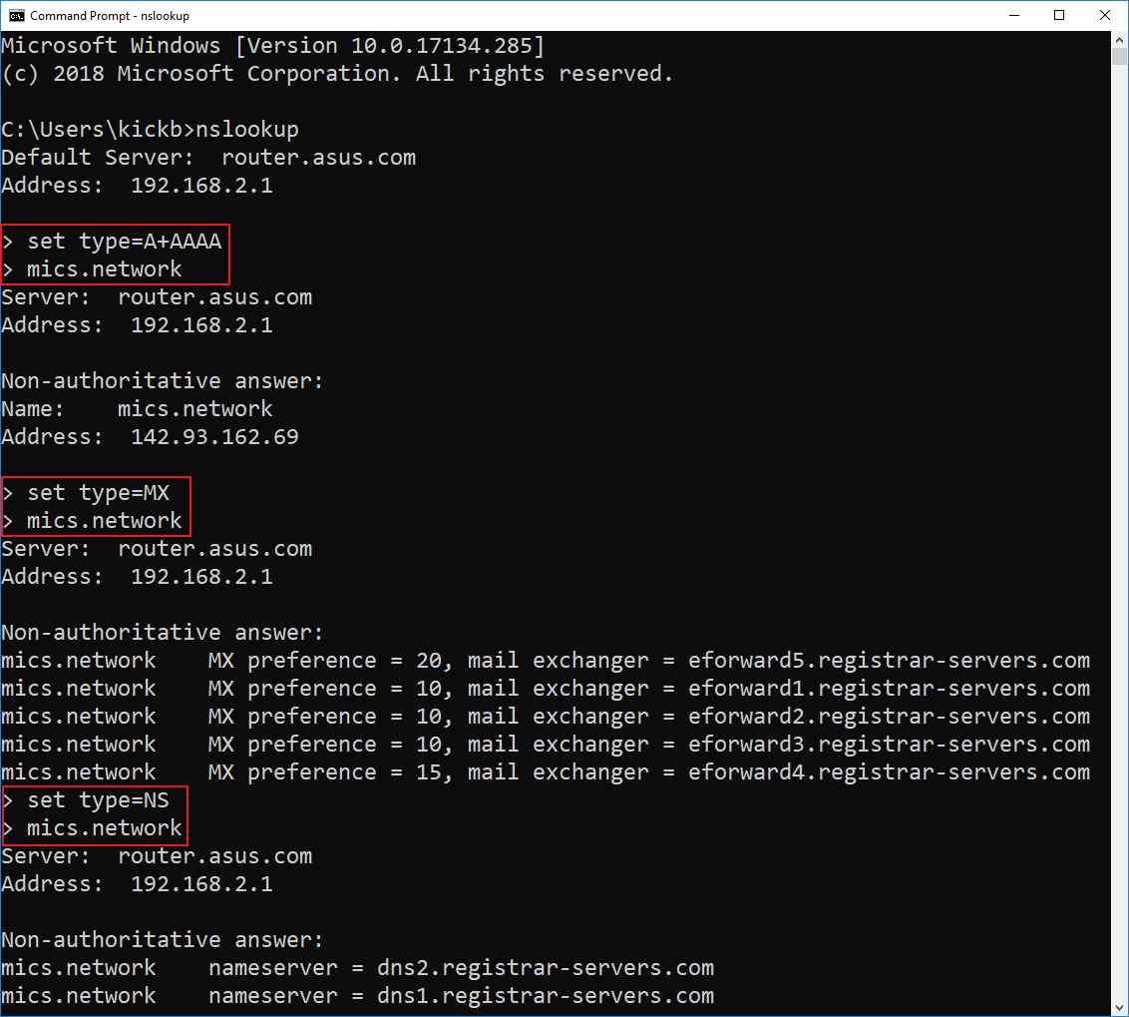
DNS Resource Record Type Fields
A | 32-bit Internet Address(es)
AAAA | 128-bit Internet Address(es)
CNAME | Canonical name for alias
MX | Mail eXchange
NS | Name Server
PTR | PoinTeR (reverse)
SOA | Start Of Authority
Notes:
Zone file record information:
A – record contains the IP address of the given domain
CNAME – Canonical name links aliases to another domain name
MX – directs domain email to server hosting
NS – records determine servers that communicate DNS information for a given domain
PTR – used for reverse lookup
SOA – Zone information – primary name server for zone, the responsible party, serial number, TTL
**Click Image to Show NS lookup**

Slide 8
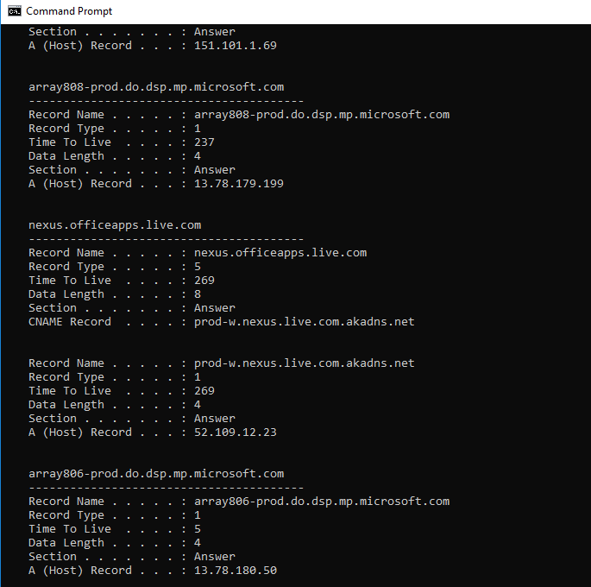
Local DNS Caching
Windows System DNS caching:
Command Prompt: ipconfig /displaydns
Includes entries from Windows Hosts file
Chrome: chrome://net-internals/#dns
Stores for one minute

Slide 9
Problems with DNS
No Security
Notes:
No Encryption
No Authentication or Integrity
One can argue there is Availability with 13 Root DNS servers

Slide 10

DNS Attacks
Notes:
DNS is an application layer protocol running on UDP
Unencrypted and Unauthenticated traffic

Slide 11

Common DNS Attacks
Amplification
Covert Channel Transmission
DNS Spoofing
Cache Poisoning
MITM
Compromised DNS Server
Notes:
Amplification – spoofing sender IP to send large amounts of traffic to victim (sender)
Cache Poisoning – Attacker introduces bogus data into recursive nameserver’s cache
MITM - intercepting DNS packets and reading or modifying

Slide 12
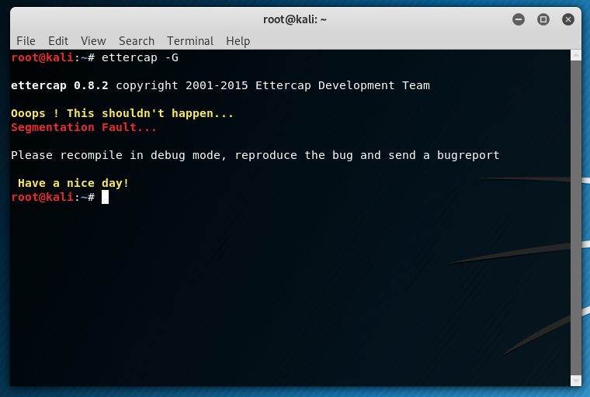
DNS Spoofing Demo

Slide 13

DNSSEC
Notes:
DNSSEC
Domain Name System Security Extensions
In 1999 IETF Proposed DNSSEC standard
Provides integrity of DNS requests from authoritative servers by digitally signing them

Slide 14
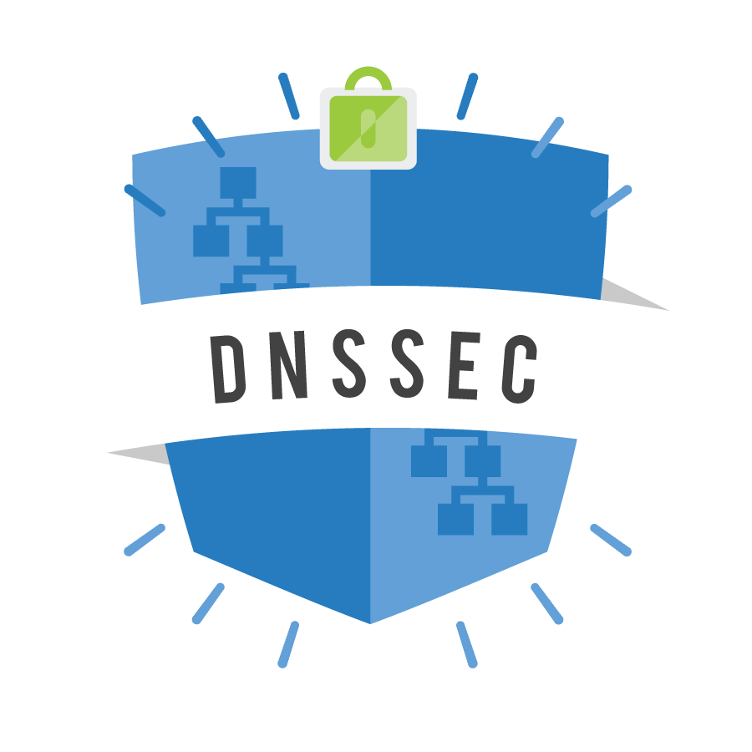
DNSSEC
Domain Name System Security Extensions
Solves the problem of Integrity via Digital Signatures
DNS resolution is known to be authentic
Protects against spoofing attacks
Backwards compatible
Last mile problem
Expensive
DANE
Confidentiality
Integrity
Availability
Notes:
Data Origin is authentic – the response came from ‘.com’ zone
Data Integrity – An attacker cannot perform a MITM attack
Does not offer additional protections to confidentiality or availability
Denial of service attacks
No Encryption
Last mile problem: although it has been validated up to the Resolver, it is possible the resolver is compromised or potential for a MITM
DANE protocol (DNS-based Authentication of Named Entities): A good example of the use website TLS certificates can be stored within the DNSSEC protocol as TLSA resource records

Slide 15
DNSSEC Additional Record Type Fields
RRSIG | Cryptographic signature
DNSKEY | Public signing key
DS | Hash of the DNSKEY record
NSEC / NSEC3 | Explicit denial-of-existence of a DNS record
CDNSKEY/CDS | Child zone requesting updates to DS record(s) in parent zone
Notes:
Each zone has public/private key pair – validate authenticity and integrity
Public key is stored in DNSKEY record
NSEC – Next Secure Record
NSEC3 – improved version with hashed values
*DEMO DNSSEC*

Slide 16
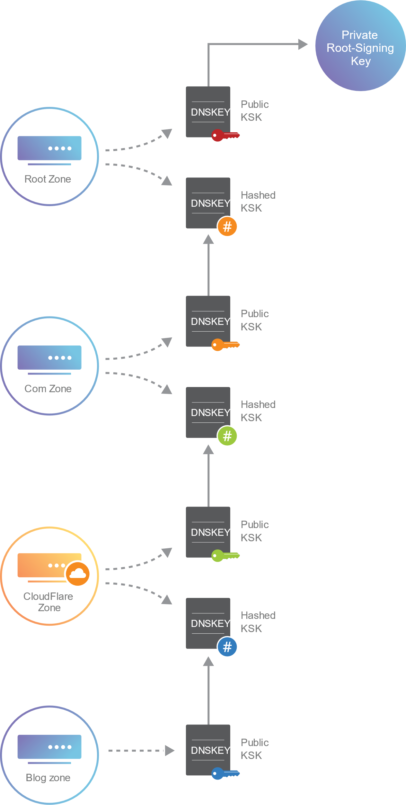
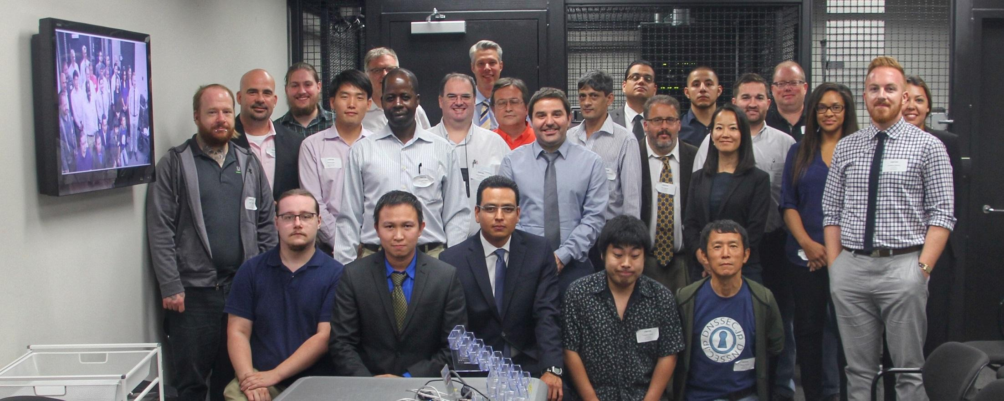
DNSSEC - Chain of Trust
Hash Public KSK (Key Signing Key) up chain
Root zone has no DS record to compare
Root Signing Ceremony
Notes:
Resolvers compare hash of Public KSK
DS - Delegation Signer records – transfers trust to child zone
Root zone was signed in 2010.
How do you trust the Root Zone?
Root Signing Ceremony – World’s most elite DNS nerds
Public, audited, tightly controlled ceremony

Slide 17
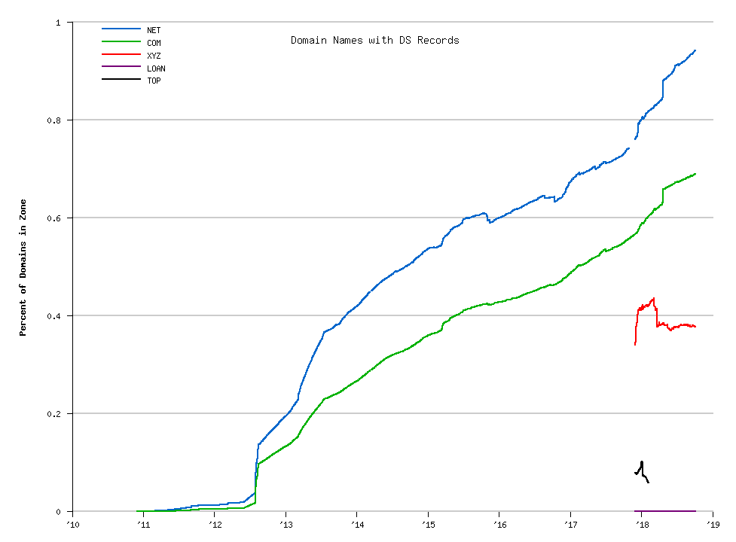
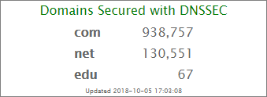
Verisign Percentage of Domain Names with DS Records
Notes:
Verisign – Root Zone Server A

Slide 18
DNS over HTTPS
Notes:
DNS is unencrypted and no authentication or integrity checking exists
DNSSEC provides integrity with Digital Signatures
DOH It is what it sounds like, utilizing HTTPS protocol to encrypt DNS traffic requests

Slide 19
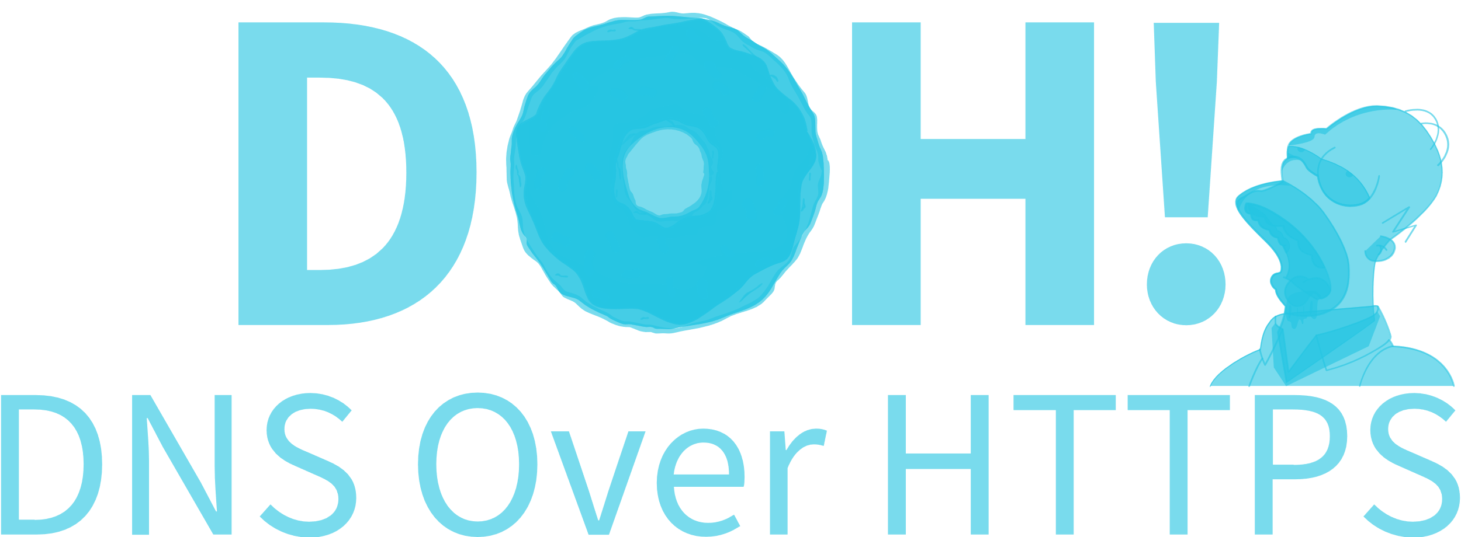
Provides Confidentiality, Integrity via HTTPS
Google and Cloudflare offer DOH
Relies on trusting recursive resolver
Ensures reliable transmission of Ads
DNS-Over-HTTPS on PiHole
Intra (Android)
Confidentiality
Integrity
Availability
Notes:
Transmitted traffic is encrypted over HTTPS
Replaces your ISP as your trusted resolver
Prevents MITM attacks
Prevents ISP or other part in traffic path from seeing your DNS requests
Firefox by defaults to cloudflare as a “trusted recursive resolver”
DOH would have prevented the attack I performed on DNS spoofing as the traffic would have been encrypted
Cloudflare claims to have a “pro-user privacy policy” and deletes logs after 24 hours. Could a gov’t agency track your activity by requesting CF provide it?
DNS-Over-HTTPS on PiHole: route DNS traffic through RaspberryPi to block ad-serving domains, and improves network performance
Intra is Google’s effort at making an easy to use DOH mobile app
There are other technologies that I did not discuss: DoTLS, DNSCurve, DNSCrypt, DNS over Tor
DoH is a solution that offers Confidentiality and Integrity

Slide 20
Questions?

